Slide 1
Sentiments classification for US airline companies
Najla AlDossary

Slide 2
Plan
Introduction
Methodology
Results
Conclusion

Slide 3
Introduction

Slide 4
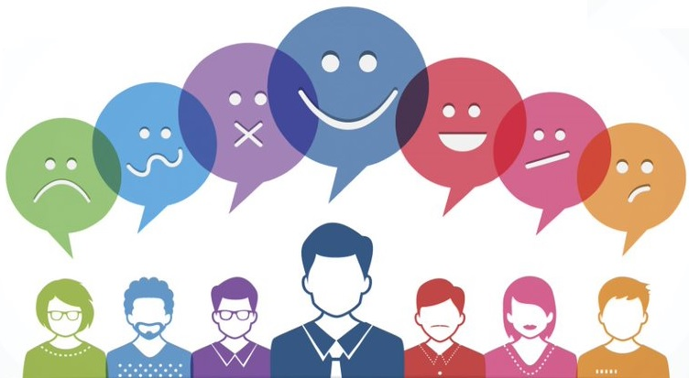
Context
Customer feedback is a very important player in the airline industry because it helps companies to improve their services.
One of the traditional methods to achieve this goal is to ask for customer satisfaction by questionnaires or forms. But These procedures are time consuming and require a lot of resources.
Can we use a data science approach to get those feedbacks ?

Slide 5
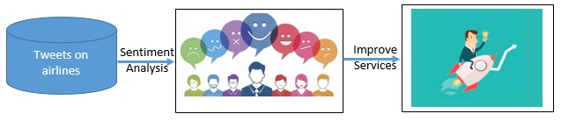
Motivation
Twitter produces a high quantity of textual content which mostly represents customers' opinions.
The availability of such text datasets through twitter API.
The availability of machine learning and data science models in order to build a sentiment classifier from twitter data.

Slide 6
Methodology

Slide 7
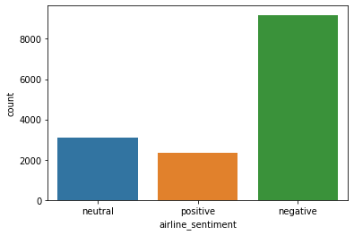
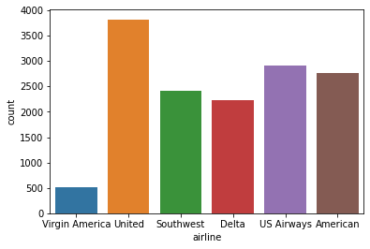
Data analysis
The data used is from Kaggle with more than 14640 tweets.
Tweets with negative sentiments are more frequent. Therefore, Machine learning models that we will build will likely predict negative sentiments with high accuracy.
United airlines related tweets are more frequent.

Slide 8
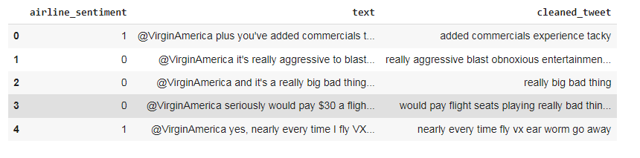
Data cleaning
The training of machine learning models without data cleaning can affect models performances. That’s why we perform the following preprocessing steps:
Removing punctuations .
All text in the tweets was converted to lowercase.
Removing stop words and numbers from the tweets.

Slide 9
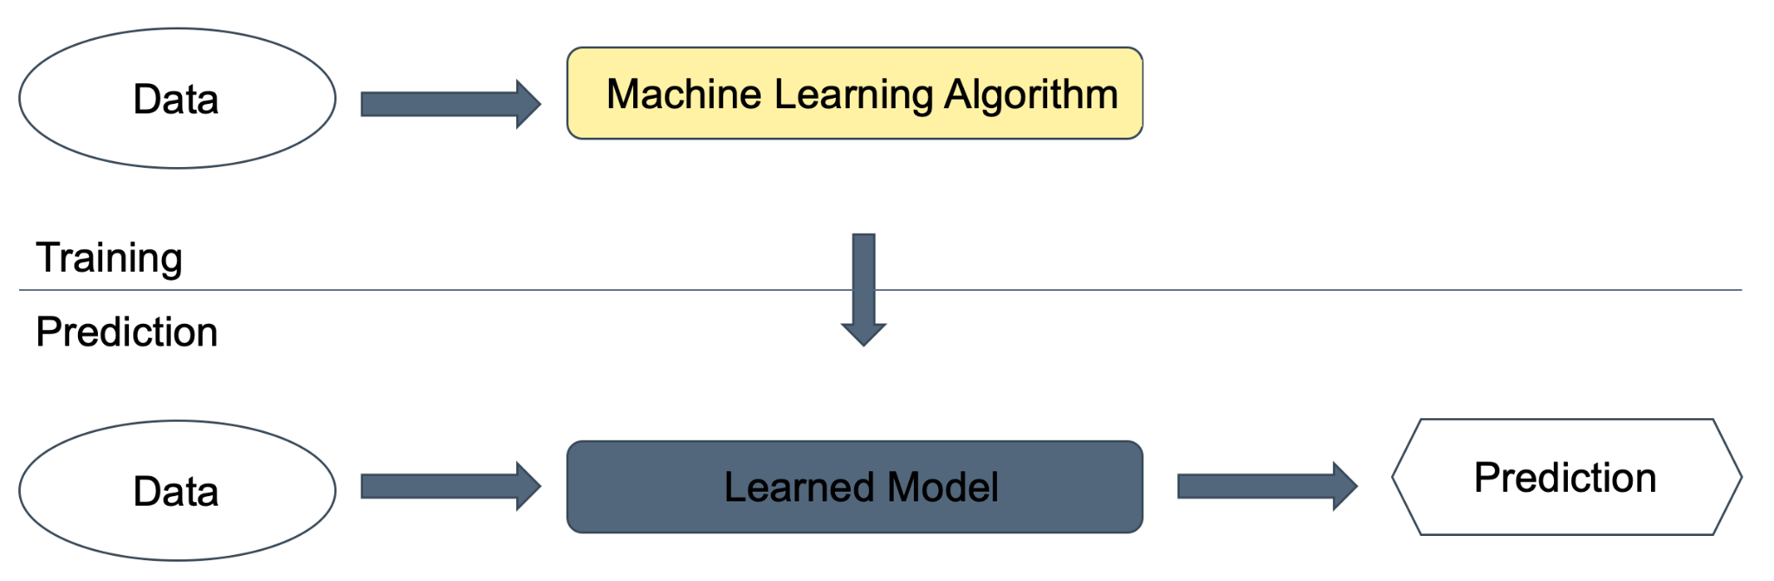
Machine learning models
We train and evaluate 3 machine learning models which are : Random Forest, Logistic Regression and Adaptive boosting.

Slide 10
Results

Slide 11
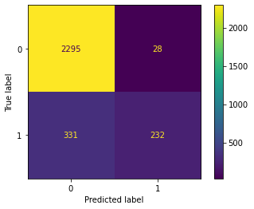
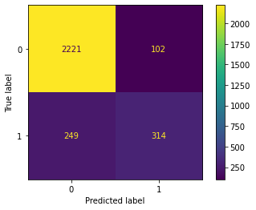
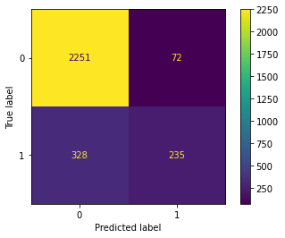
Confusion matrix
We can observe that all the models have a high True negative rate which is good for our problem
as we need to predict negative tweets more than positive tweets.
Logistic Regression Random Forest Adaptive Boosting

Slide 12
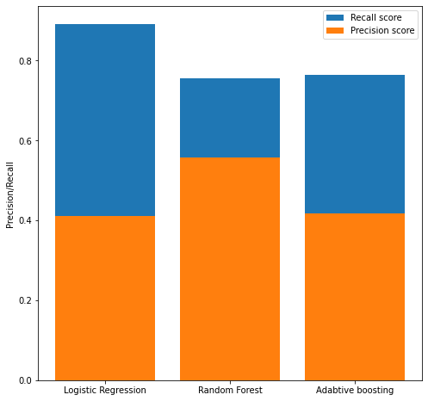
Precision & Recall
Logistic regression has the highest Recall which means a lower false negative which is the ideal case
for our question.

Slide 13
Conclusion

Slide 14
In this project we investigate the extraction of sentiments from tweets based on data science approaches. The use case we choose which is the tweets related to airline industry shows that ability of machine learning models of predicting the sentiments of clients from their tweets. It is an interesting results as they can build their future decisions from those predictions in order to improve their services.

